Slide 1
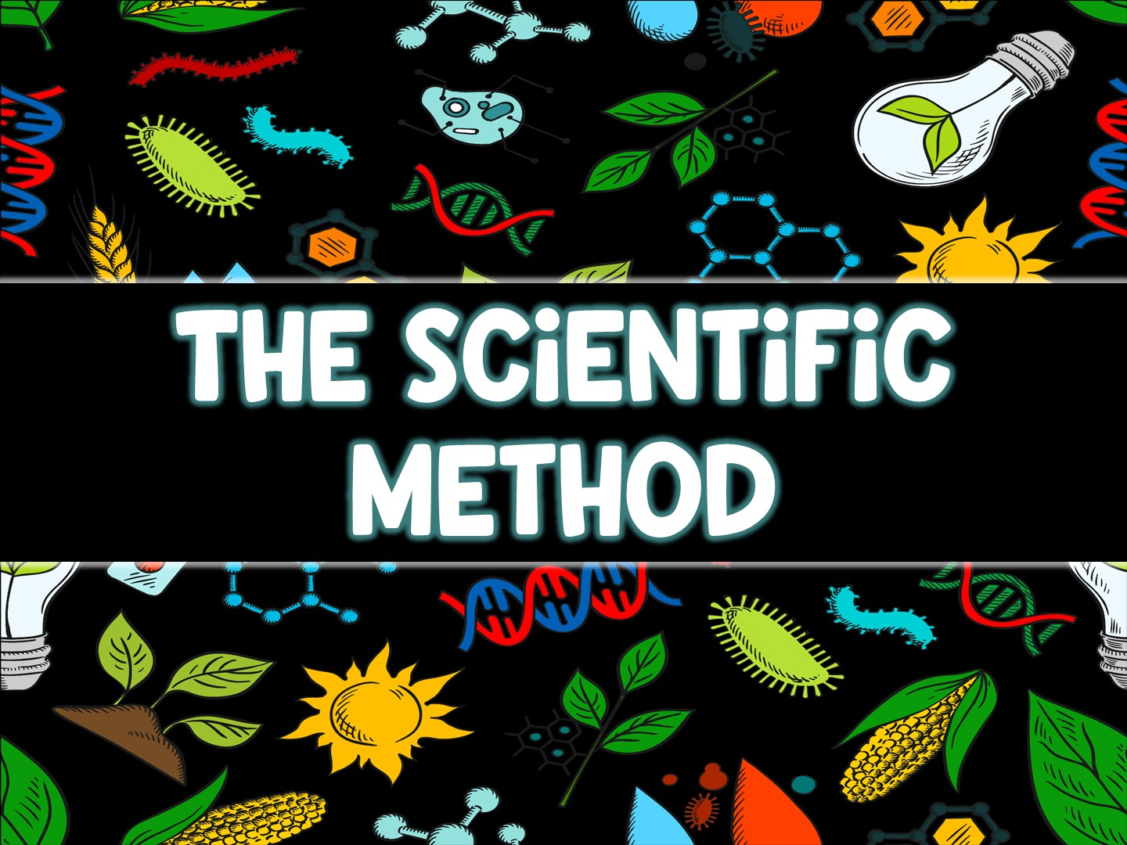

Slide 2
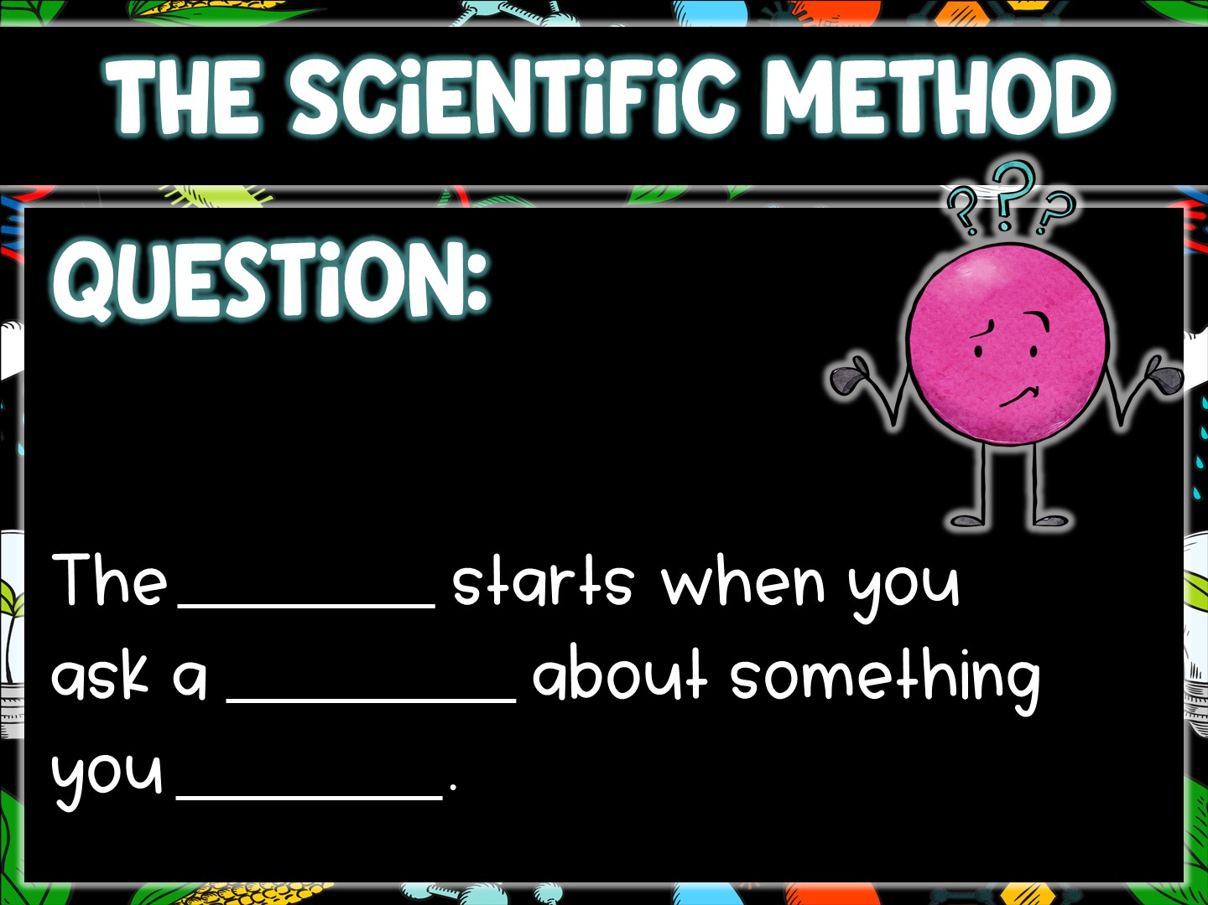
process
question
observe

Slide 3
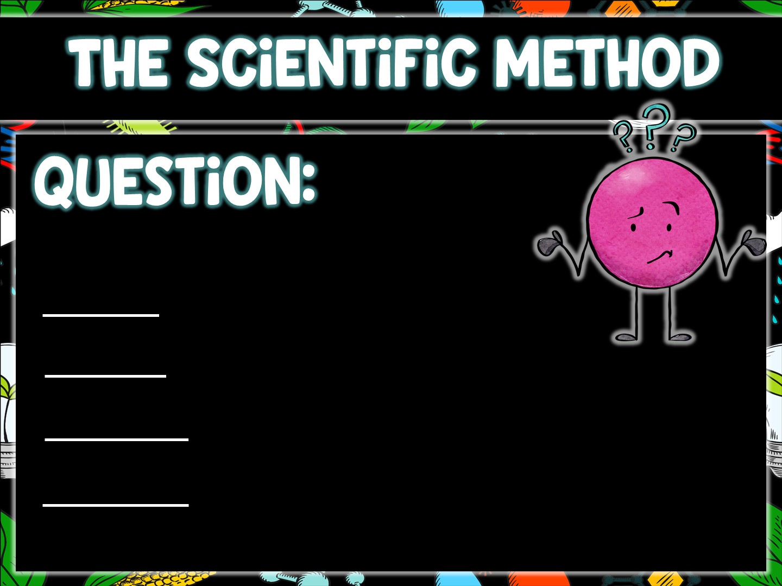
Why?
How?
When?
What?

Slide 4
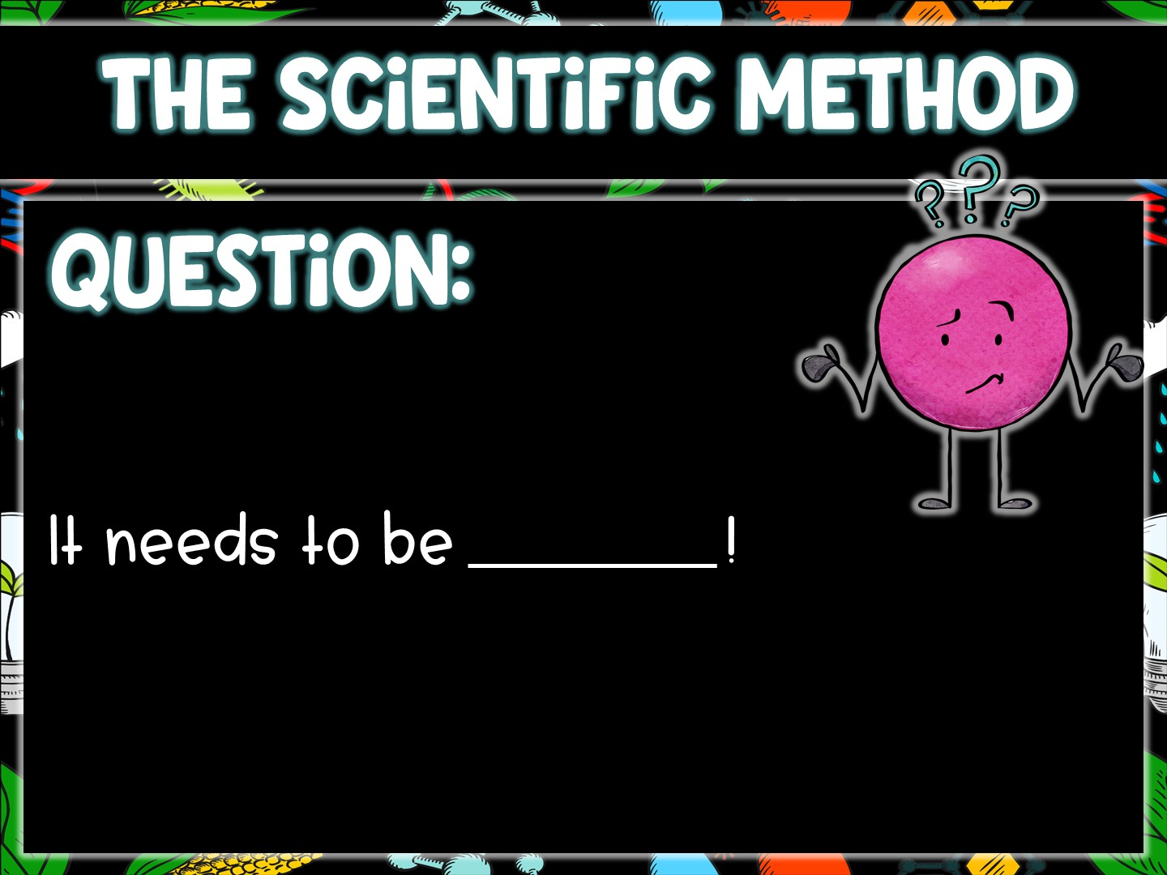
testable

Slide 5
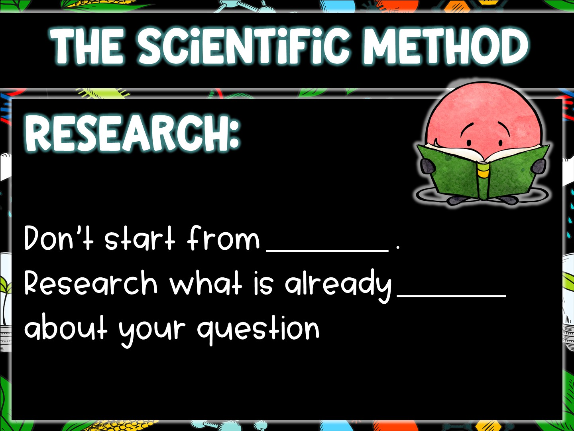
nothing
known

Slide 6
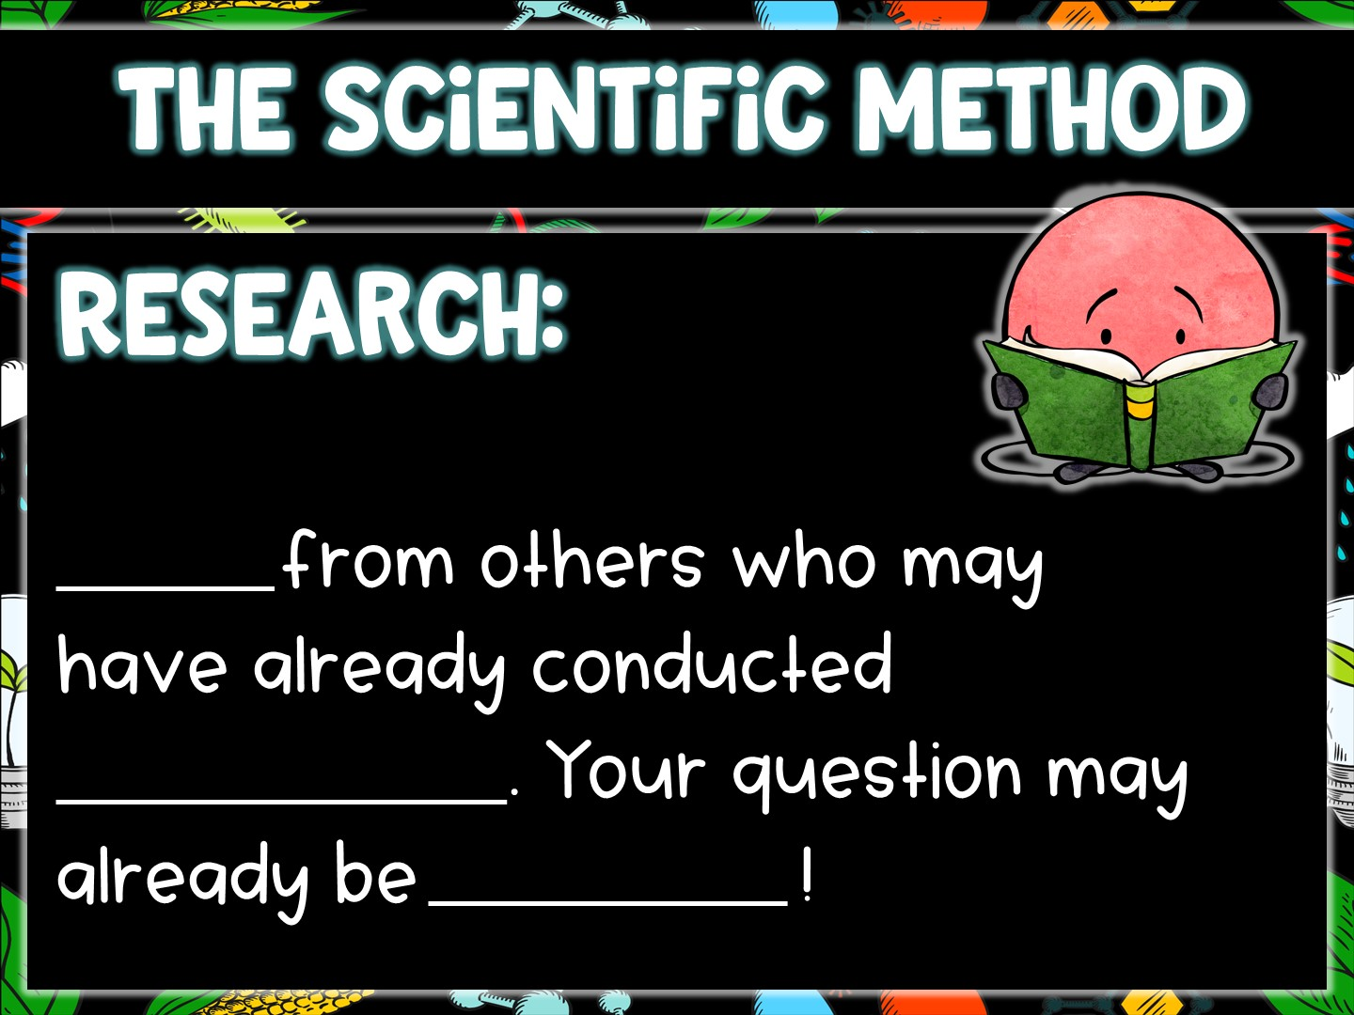
Learn
experiments
answered

Slide 7
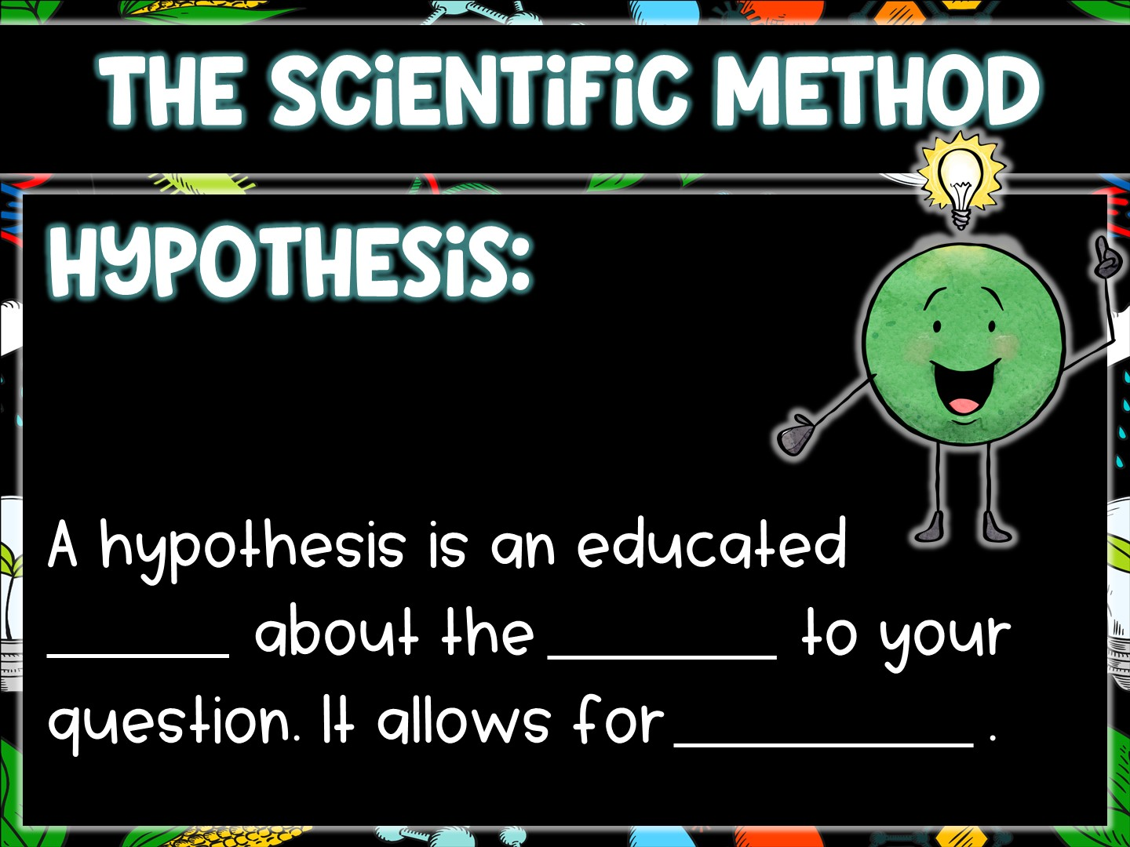
guess
answer
prediction

Slide 8
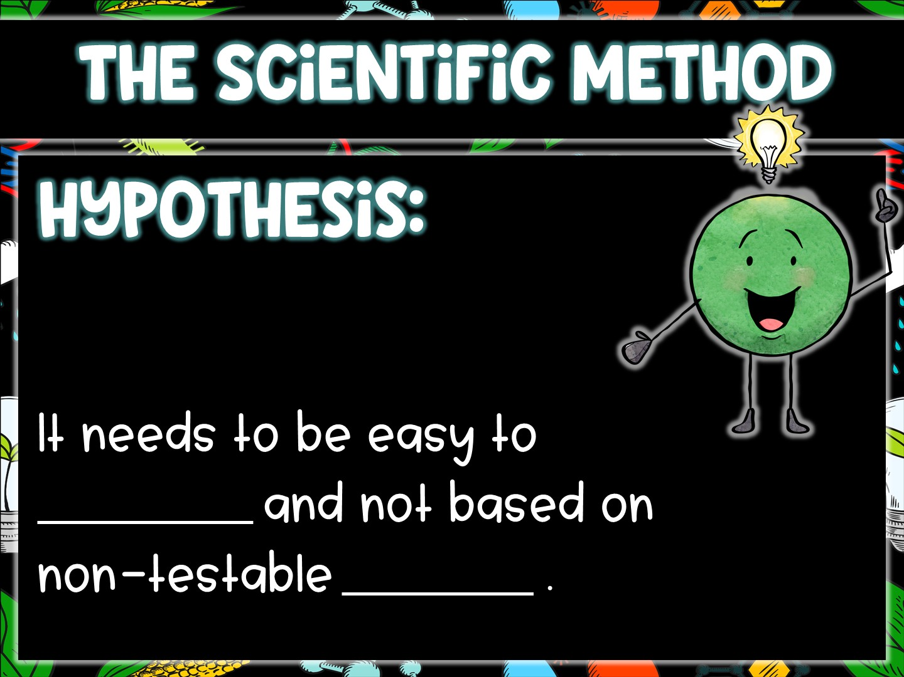
measure
opinion

Slide 9
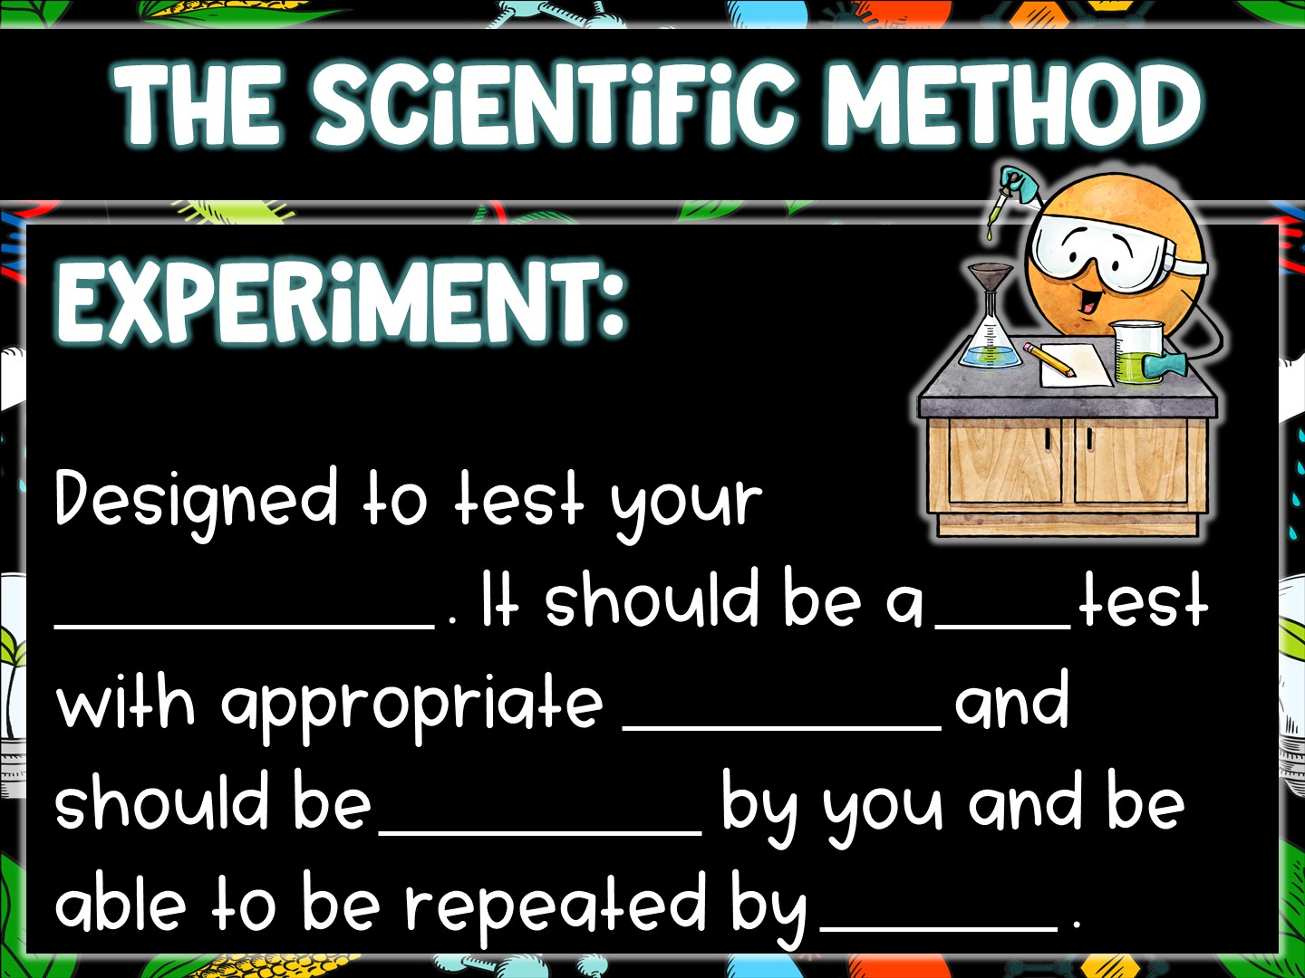
hypothesis
fair
variables
repeated
others

Slide 10
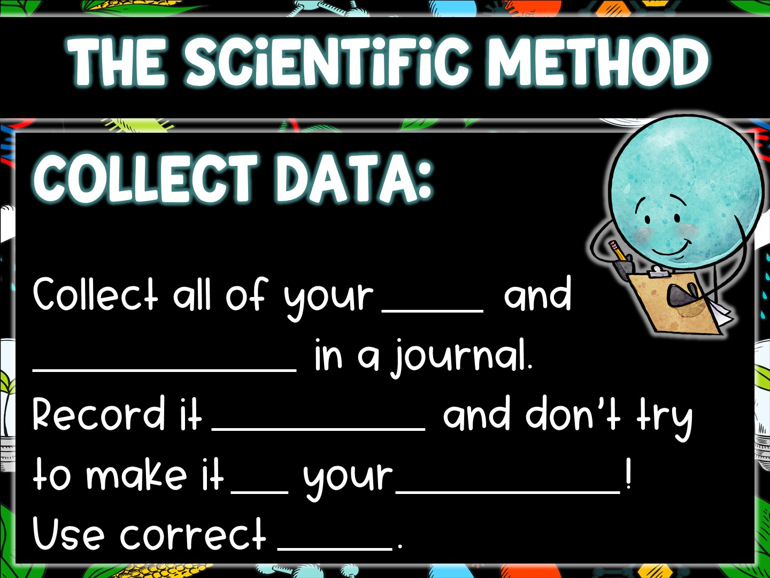
data
observations
accurately
fit
hypothesis
units

Slide 11
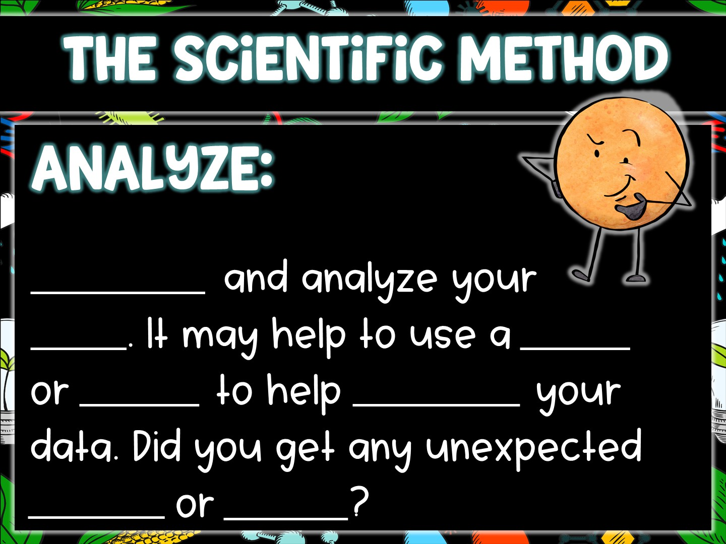
Organize
data
chart
graph
visualize
results
errors

Slide 12
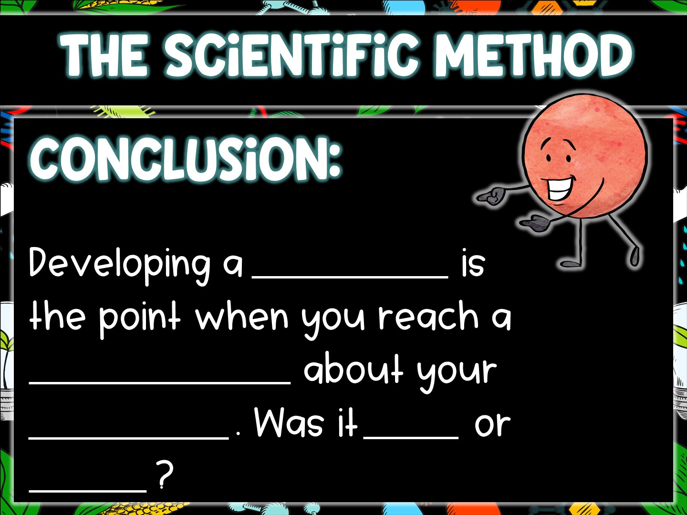
conclusion
determination
hypothesis
right
wrong

Slide 13
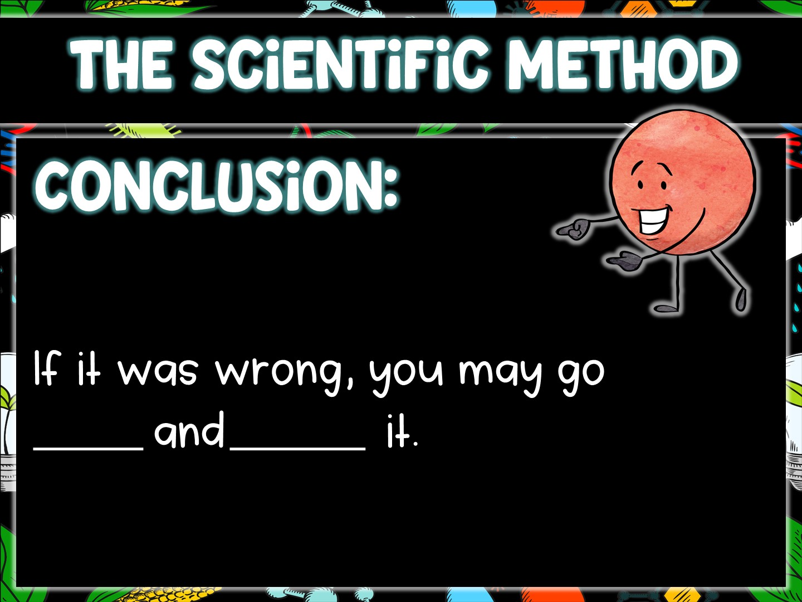
back
revise

Slide 14
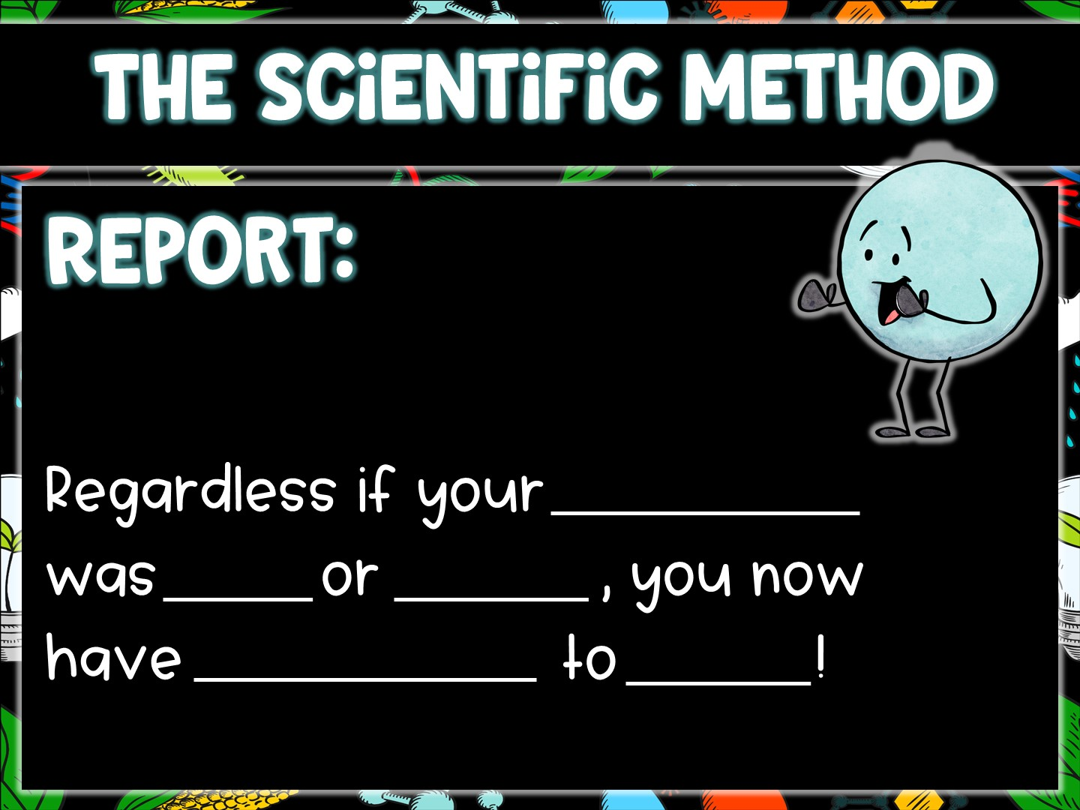
hypothesis
right
wrong
information
share

Slide 15
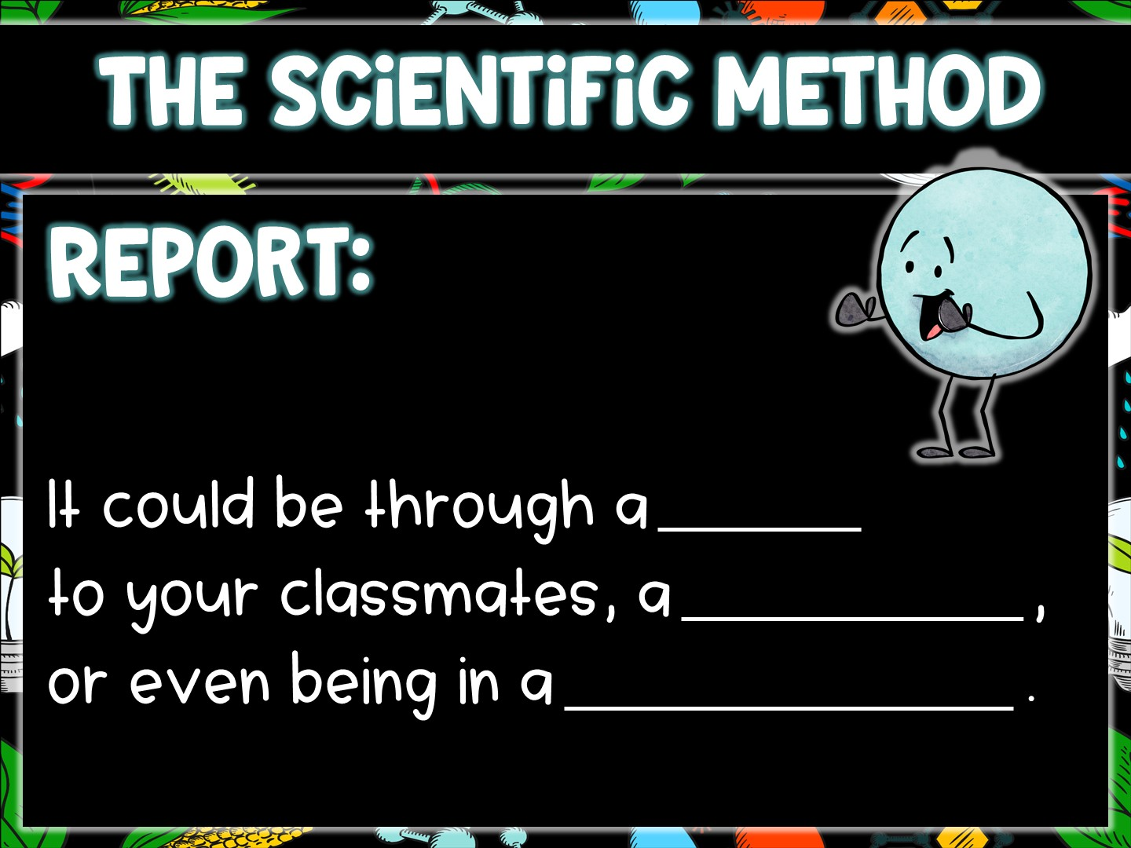
report
science fair
science journal

